Slide 1

Build a Time Machine with AI + GIS
National 4H GIS Team 2025

Slide 2
Workshop Objectives
01
02
03
04
05
Use GIS and AI to explore local history
Visualize how neighborhoods and communities change over time
Learn about real-world careers in history,planning, and technology
Build your own historical narrative using maps and visual storytelling
Understand how tools like AI and GIS can preserve memory and shape the future

Slide 3
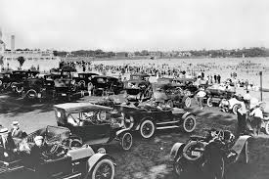
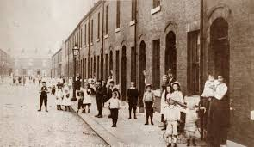
Warm up
Who lived on your street 100 years ago?

Slide 4
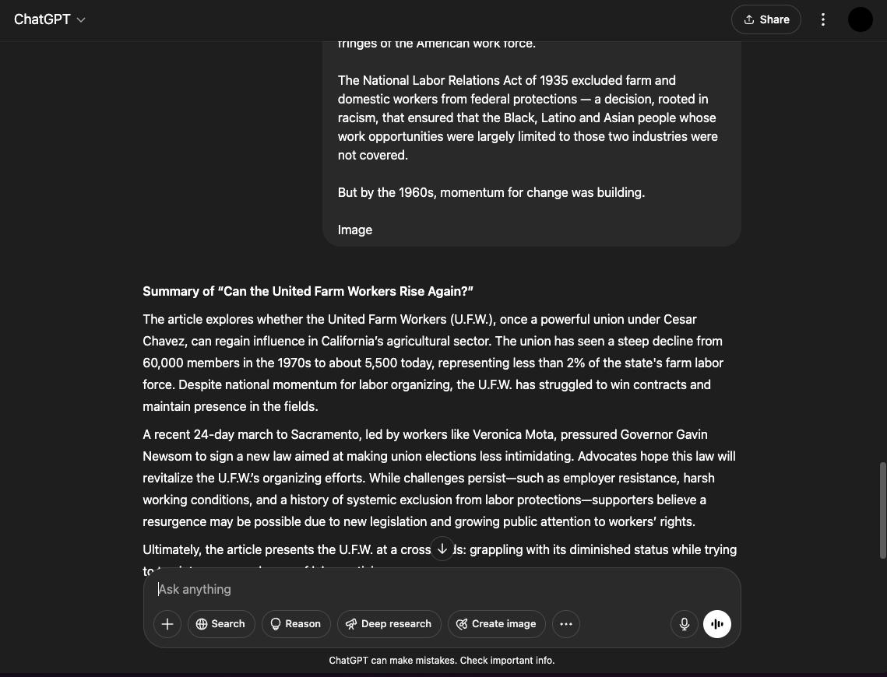
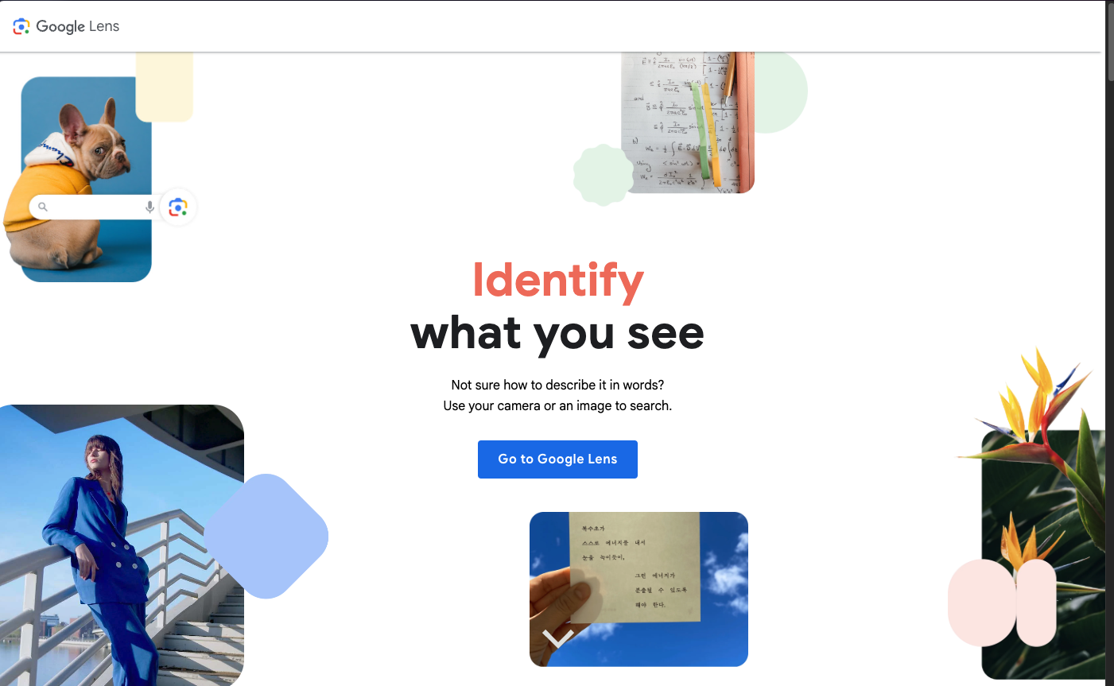
AI in History
ChatGPT/ LLMs (Large Language Models)
Google Lens/ ArcGIS Image Analyst

Slide 5
Discussion
What can AI help us discover about the past?

Slide 6
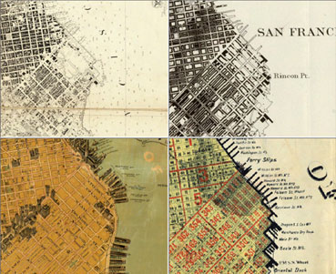
GIS as a Time Machine
City Planning and Historic Preservation StoryMap
GIS is like a flipbook
Each map is a page in time
When we flip through them, we can see what changes
What can GIS show us?
How cities grow bigger
Where forests disappear
Where animals move to

Slide 7
Rediscover a Village
Materials Needed:
Historical Freedmen's Village map (provided)
Tracing paper OR digital tablet with mapping app
Colored markers/pencils (red, blue, green)
Prepare Your Map
Paper option: Place tracing paper over historical map
Digital option: Import village map as background layer
Mark Historical Structures
Use RED to circle homes/residences
Use BLUE to mark churches/community buildings
Use GREEN to identify businesses/work areas
Label at least 5 significant locations
Create Modern Comparison
Switch to current map of same area
Place your tracing over it OR switch layers digitally
Note what exists in these locations today

Slide 8
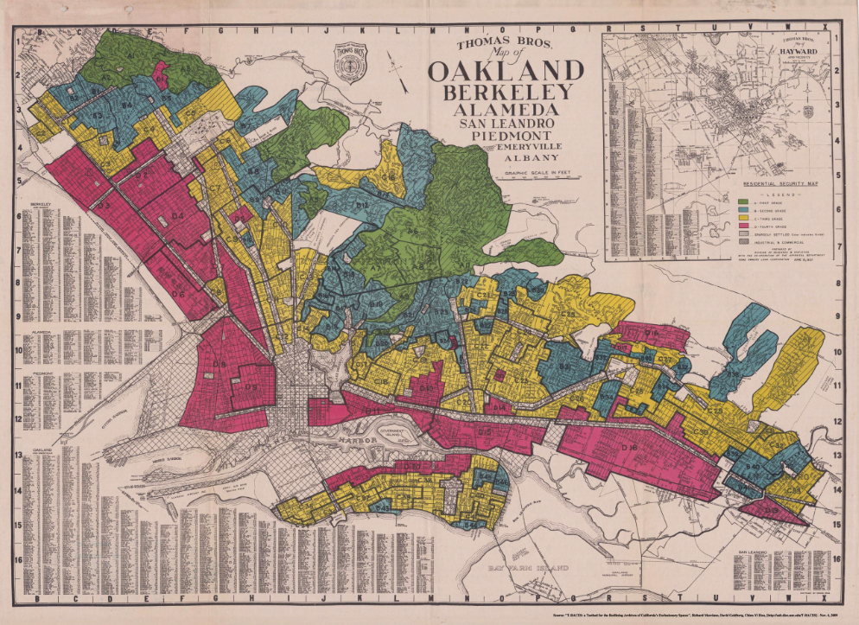
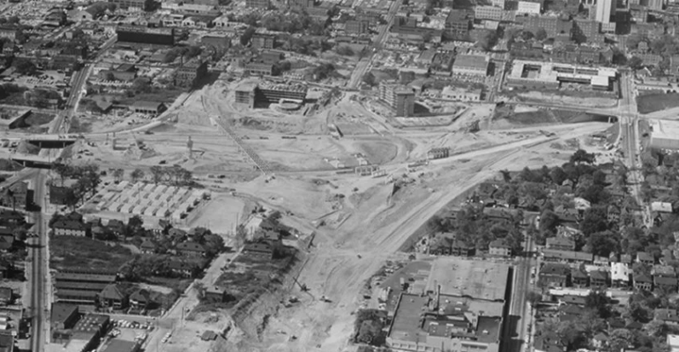
Mapping Memory & Land Loss
Redlining:
financial institutions systematically denied services to residents of specific neighborhoods based primarily on race/ethnicity (1930s-1970s)
Created lasting wealth disparities by preventing minority communities from building home equity and accessing economic opportunities
Urban renewal:
Government program (1950s-1970s) that demolished "blighted" neighborhoods—predominantly minority communities—displacing residents and destroying established cultural centers under the appearance of modernization and development
Highway construction:
Federal Interstate Highway System strategically routed highways through minority neighborhoods, destroying communities and creating physical barriers that reinforced segregation while prioritizing suburban commuter needs
We map so we don’t forget

Slide 9
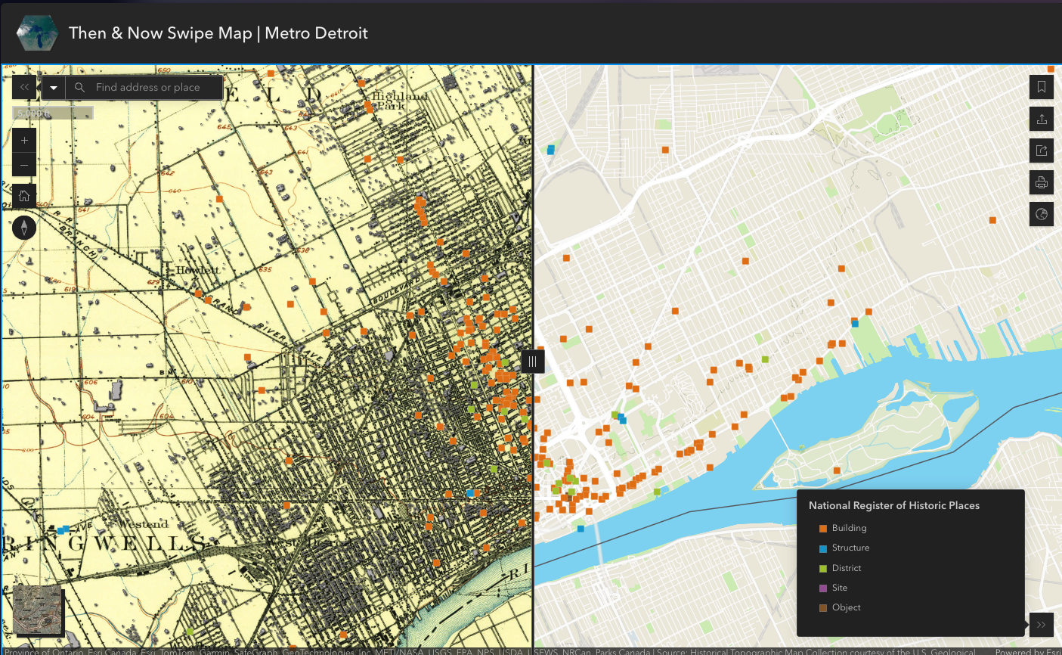
Then vs Now Map Builder
Choose a location to analyze:
Your neighborhood
School grounds and surrounding area
Local historical site or downtown area
Creating Comparison Layers:
Option 1: Physical Method
Use printed historical maps as base layer
Overlay transparent sheets to trace current features
Mark preserved structures in green, changed areas in red
Option 2: Digital Method
Use ArcGIS or Felt.com mapping tools
Import historical imagery as base layer
Create comparison points between time periods
Toggle visibility between time periods

Slide 10
Build a Time Machine Map
Use this trifold template
Panel 1: 1890-1920
Draw or trace the historical map of your chosen location
Use brown/sepia colors for an authentic look
Write: "This place used to be ________________"
Include at least 3 historical landmarks or features
Panel 3: Today
Draw the current appearance of your location
Use modern colors and labels
Highlight what replaced historical elements
Write: "This place used to be ________________"
Panel 2: 1950-1980
Show the mid-century development of your location
Circle and label key changes from Panel 1
Use arrows to indicate new developments
Write: "This place used to be ________________"

Slide 11
GIS Historian
Archivist
Community Preservationist
Urban Planner
Civic Tech Storyteller
History Careers & Digital Humanities
Creates interactive maps showing historical patterns, migrations, and spatial analysis
Preserves and digitizes historical documents, develops searchable databases
Documents local heritage using digital tools, often with community involvement
Uses historical data to guide sustainable development and historic district management
Develops digital narratives and visualization tools to make history accessible

Slide 12
How to Get Involved
Apply to National 4-H Geospatial Leadership Team
Join Wake 4-H GIS Team
Try SparkNC Mapping

Slide 13


